Slide 1

Slides for Chapter 5:
Remote invocation
From Coulouris, Dollimore, Kindberg and Blair
Distributed Systems:
Concepts and Design
Edition 5, © Addison-Wesley 2012

Slide 2
Figure 5.1
Middleware layers
Applications
This chapter
(and Chapter 6)
Remote invocation, indirect communication
Middleware
Underlying interprocess communication primitives:
layers
Sockets, message passing, multicast support, overlay networks
UDP and TCP
Instructor’s Guide for Coulouris, Dollimore, Kindberg and Blair, Distributed Systems: Concepts and Design Edn. 5
© Pearson Education 2012

Slide 3
Figure 5.2
Request-reply communication
Client
Server
doOperation
Request
message
getRequest
select object
(wait)
execute
Reply
method
message
sendReply
(continuation)
Instructor’s Guide for Coulouris, Dollimore, Kindberg and Blair, Distributed Systems: Concepts and Design Edn. 5
© Pearson Education 2012

Slide 4
Figure 5.3
Operations of the request-reply protocol
public byte[] doOperation (RemoteRef s, int operationId, byte[] arguments)
sends a request message to the remote server and returns the reply.
The arguments specify the remote server, the operation to be invoked and the
arguments of that operation.
public byte[] getRequest ();
acquires a client request via the server port.
public void sendReply (byte[] reply, InetAddress clientHost, int clientPort);
sends the reply message reply to the client at its Internet address and port.
Instructor’s Guide for Coulouris, Dollimore, Kindberg and Blair, Distributed Systems: Concepts and Design Edn. 5
© Pearson Education 2012

Slide 5
Figure 5.4
Request-reply message structure
messageType
int (0=Request, 1= Reply)
requestId
int
remoteReference
RemoteRef
operationId
int or Operation
arguments
array of bytes
Instructor’s Guide for Coulouris, Dollimore, Kindberg and Blair, Distributed Systems: Concepts and Design Edn. 5
© Pearson Education 2012

Slide 6
Figure 5.5
RPC exchange protocols
Name
Messages sent by
Client
Server
Client
R
Request
R
R
Request
Reply
R
R
A
Request
Reply
Acknowledge reply
Instructor’s Guide for Coulouris, Dollimore, Kindberg and Blair, Distributed Systems: Concepts and Design Edn. 5
© Pearson Education 2012

Slide 7
Figure 5.6
HTTP request message
method
URL or pathname
HTTP version
headers
message body
GET
//www.dcs.qmw.ac.uk/index.html
HTTP/ 1.1
Instructor’s Guide for Coulouris, Dollimore, Kindberg and Blair, Distributed Systems: Concepts and Design Edn. 5
© Pearson Education 2012

Slide 8
Figure 5.7
HTTP Reply message
HTTP version
status code
reason
headers
message body
HTTP/1.1
200
OK
resource data
Instructor’s Guide for Coulouris, Dollimore, Kindberg and Blair, Distributed Systems: Concepts and Design Edn. 5
© Pearson Education 2012

Slide 9
Figure 5.8
CORBA IDL example
// In file Person.idl
struct Person {
string name;
string place;
long year;
} ;
interface PersonList {
readonly attribute string listname;
void addPerson(in Person p) ;
void getPerson(in string name, out Person p);
long number();
};
Instructor’s Guide for Coulouris, Dollimore, Kindberg and Blair, Distributed Systems: Concepts and Design Edn. 5
© Pearson Education 2012

Slide 10
Figure 5.9
Call semantics
Fault tolerance measures
Call
semantics
Retransmit request
Duplicate
Re-execute procedure
message
filtering
or retransmit reply
No
Not applicable
Not applicable
Maybe
Yes
No
Re-execute procedure
At-least-once
Yes
Yes
Retransmit reply
At-most-once
Instructor’s Guide for Coulouris, Dollimore, Kindberg and Blair, Distributed Systems: Concepts and Design Edn. 5
© Pearson Education 2012

Slide 11
Figure 5.10
Role of client and server stub procedures in RPC
client process
server process
Request
Reply
client stub
server stub
procedure
procedure
client
service
program
Communication
Communication
procedure
module
module
dispatcher
Instructor’s Guide for Coulouris, Dollimore, Kindberg and Blair, Distributed Systems: Concepts and Design Edn. 5
© Pearson Education 2012

Slide 12
Figure 5.11
Files interface in Sun XDR
const MAX = 1000;
typedef int FileIdentifier;
typedef int FilePointer;
typedef int Length;
struct Data {
int length;
char buffer[MAX];
};
struct writeargs {
FileIdentifier f;
FilePointer position;
Data data;
};
struct readargs {
FileIdentifier f;
FilePointer position;
Length length;
};
program FILEREADWRITE {
version VERSION {
void WRITE(writeargs)=1; 1
Data READ(readargs)=2; 2
}=2;
} = 9999;
Instructor’s Guide for Coulouris, Dollimore, Kindberg and Blair, Distributed Systems: Concepts and Design Edn. 5
© Pearson Education 2012

Slide 13
Figure 5.12
Remote and local method invocations
remote
local
C
invocation
invocation
local
E
invocation
remote
B
invocation
F
A
local
invocation
D
Instructor’s Guide for Coulouris, Dollimore, Kindberg and Blair, Distributed Systems: Concepts and Design Edn. 5
© Pearson Education 2012

Slide 14
Figure 5.13
A remote object and its remote interface
remote
object
remote
Data
interface
m4
{
m1
implementation
m2
m5
m3
of methods
m6
Instructor’s Guide for Coulouris, Dollimore, Kindberg and Blair, Distributed Systems: Concepts and Design Edn. 5
© Pearson Education 2012

Slide 15
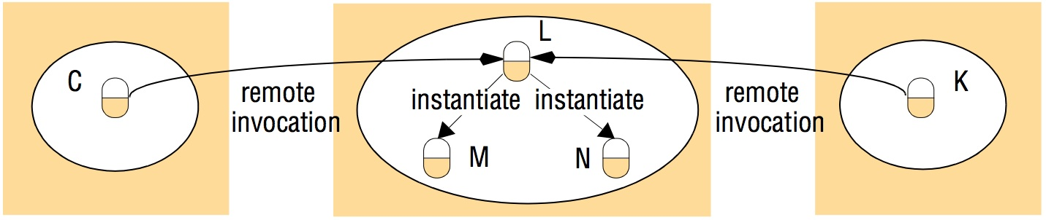
Figure 5.14
Instantiation of remote objects
Instructor’s Guide for Coulouris, Dollimore, Kindberg and Blair, Distributed Systems: Concepts and Design Edn. 5
© Pearson Education 2012

Slide 16
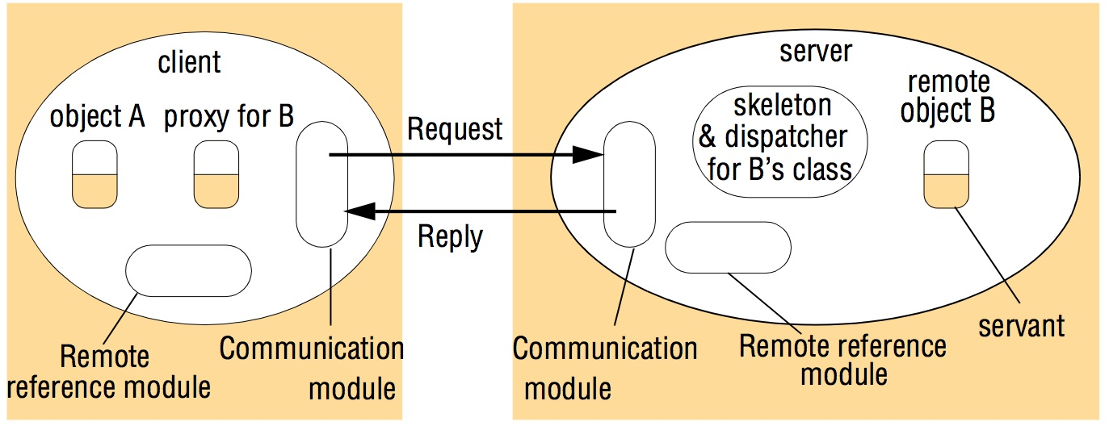
Figure 5.15
The role of proxy and skeleton in remote method invocation
Instructor’s Guide for Coulouris, Dollimore, Kindberg and Blair, Distributed Systems: Concepts and Design Edn. 5
© Pearson Education 2012

Slide 17
Figure 5.16
Java Remote interfaces Shape and ShapeList
import java.rmi.*;
import java.util.Vector;
public interface Shape extends Remote {
int getVersion() throws RemoteException;
GraphicalObject getAllState() throws RemoteException; 1
}
public interface ShapeList extends Remote {
Shape newShape(GraphicalObject g) throws RemoteException; 2
Vector allShapes() throws RemoteException;
int getVersion() throws RemoteException;
}
Instructor’s Guide for Coulouris, Dollimore, Kindberg and Blair, Distributed Systems: Concepts and Design Edn. 5
© Pearson Education 2012

Slide 18
Figure 5.17
The Naming class of Java RMIregistry
void rebind (String name, Remote obj)
This method is used by a server to register the identifier of a remote object by
name, as shown in Figure 15.18, line 3.
void bind (String name, Remote obj)
This method can alternatively be used by a server to register a remote object by
name, but if the name is already bound to a remote object reference an
exception is thrown.
void unbind (String name, Remote obj)
This method removes a binding.
Remote lookup(String name)
This method is used by clients to look up a remote object by name, as shown in
Figure 5.20 line 1. A remote object reference is returned.
String [] list()
This method returns an array of Strings containing the names bound in the registry.
Instructor’s Guide for Coulouris, Dollimore, Kindberg and Blair, Distributed Systems: Concepts and Design Edn. 5
© Pearson Education 2012

Slide 19
Figure 5.18
Java class ShapeListServer with main method
import java.rmi.*;
public class ShapeListServer{
public static void main(String args[]){
System.setSecurityManager(new RMISecurityManager());
try{
ShapeList aShapeList = new ShapeListServant(); 1
Naming.rebind("Shape List", aShapeList ); 2
System.out.println("ShapeList server ready");
}catch(Exception e) {
System.out.println("ShapeList server main " + e.getMessage());}
}
}
Instructor’s Guide for Coulouris, Dollimore, Kindberg and Blair, Distributed Systems: Concepts and Design Edn. 5
© Pearson Education 2012

Slide 20
Figure 5.19
Java class ShapeListServant implements interface ShapeList
import java.rmi.*;
import java.rmi.server.UnicastRemoteObject;
import java.util.Vector;
public class ShapeListServant extends UnicastRemoteObject implements ShapeList {
private Vector theList; // contains the list of Shapes
private int version;
public ShapeListServant()throws RemoteException{...}
public Shape newShape(GraphicalObject g) throws RemoteException { 1
version++;
Shape s = new ShapeServant( g, version); 2
theList.addElement(s);
return s;
}
public Vector allShapes()throws RemoteException{...}
public int getVersion() throws RemoteException { ... }
}
Instructor’s Guide for Coulouris, Dollimore, Kindberg and Blair, Distributed Systems: Concepts and Design Edn. 5
© Pearson Education 2012

Slide 21
Figure 5.20
Java client of ShapeList
import java.rmi.*;
import java.rmi.server.*;
import java.util.Vector;
public class ShapeListClient{
public static void main(String args[]){
System.setSecurityManager(new RMISecurityManager());
ShapeList aShapeList = null;
try{
aShapeList = (ShapeList) Naming.lookup("//bruno.ShapeList") ; 1
Vector sList = aShapeList.allShapes(); 2
} catch(RemoteException e) {System.out.println(e.getMessage());
}catch(Exception e) {System.out.println("Client: " + e.getMessage());}
}
}
Instructor’s Guide for Coulouris, Dollimore, Kindberg and Blair, Distributed Systems: Concepts and Design Edn. 5
© Pearson Education 2012

Slide 22
Figure 5.21
Classes supporting Java RMI
RemoteObject
RemoteServer
Activatable
UnicastRemoteObject
<servant class>
Instructor’s Guide for Coulouris, Dollimore, Kindberg and Blair, Distributed Systems: Concepts and Design Edn. 5
© Pearson Education 2012

